Slide 1
Today’s Topics
Pointers and Arrays: Pointer Arithmetic
Using Pointers for Array Processing
Next class:
Combining the * and ++ Operators
Using Array Name as a Pointer
Array Arguments – Pointer
Segmentation fault

Slide 2
Pointers and Arrays

Slide 3
Introduction
C allows us to perform arithmetic—addition and subtraction—on pointers to array elements.
This leads to an alternative way of processing arrays in which pointers take the place of array subscripts.
Understanding the relationship between pointers and arrays is critical for mastering C.

Slide 4
Addresses of Array elements
A program that declares an int array a with 4 elements 5, 8, 2, 9. Display the memory address of each element using & and %p.

Slide 5
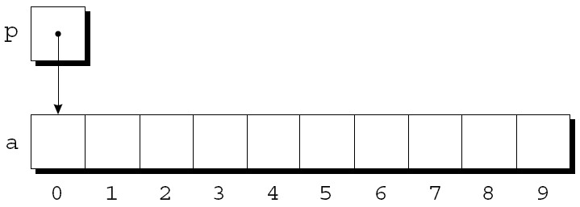
Pointer Arithmetic
Pointers can point to array elements:
int a[10];
int *p;
p = &a[0];
A graphical representation:

Slide 6
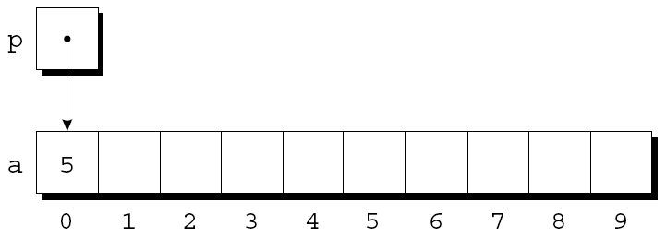
Pointer Arithmetic
We can now access a[0] through p; for example, we can store the value 5 in a[0] by writing
*p = 5;
An updated picture:

Slide 7
Pointer Arithmetic
If p points to an element of an array a, the other elements of a can be accessed by performing pointer arithmetic on p.
C supports three (and only three) forms of pointer arithmetic:
Adding an integer to a pointer
Subtracting an integer from a pointer
Subtracting one pointer from another

Slide 8


Slide 9
Adding an Integer to a Pointer
Adding an integer j to a pointer p yields a pointer to the element j places after the one that p points to.
More precisely, if p points to the array element a[i], then p + j points to a[i+j].

Slide 10
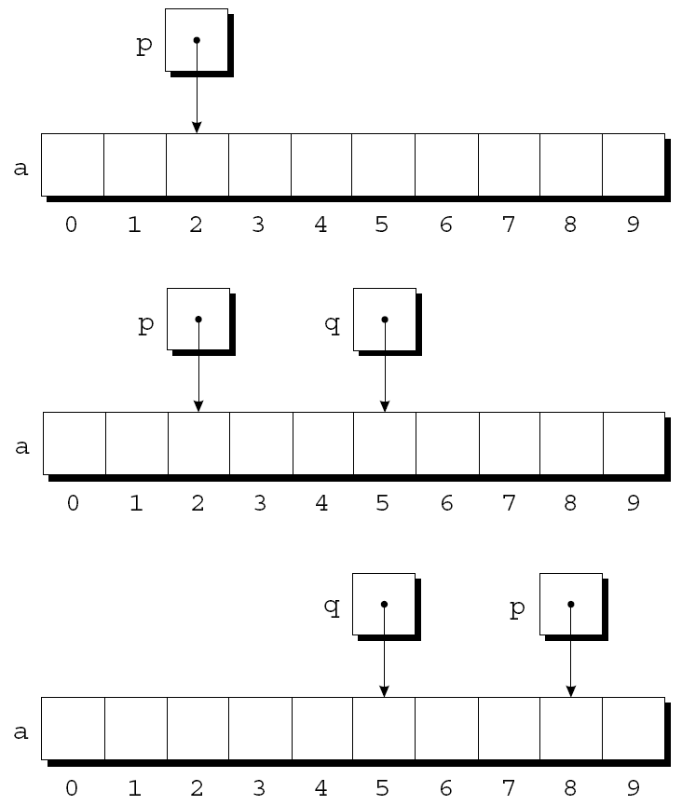
Adding an Integer to a Pointer
int a[10];
int *p, *q, i;
p = &a[2];
q = p + 3;
p += 6;

Slide 11
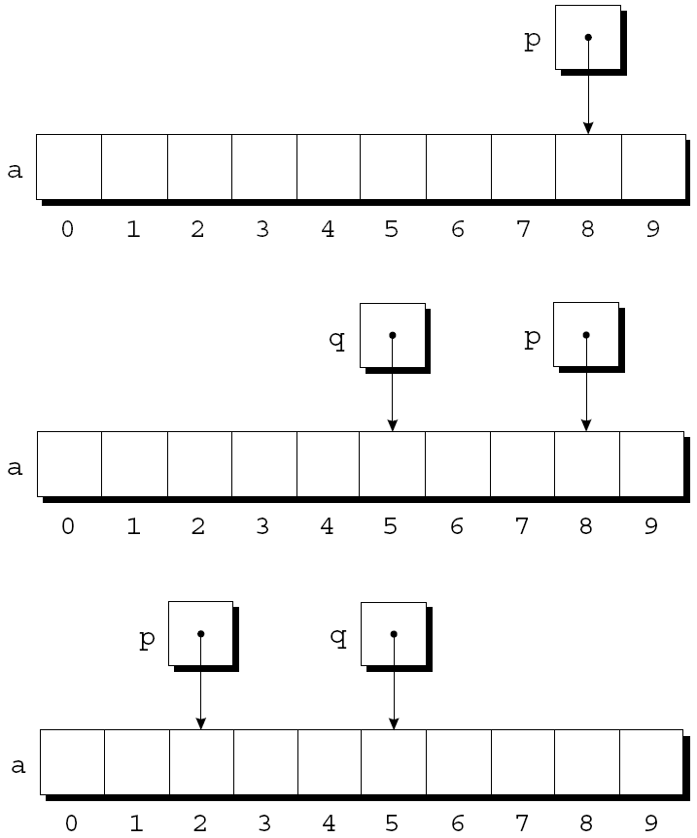
Subtracting an Integer from a Pointer
If p points to a[i], then p - j points to a[i-j].
p = &a[8];
q = p - 3;
p -= 6;

Slide 12
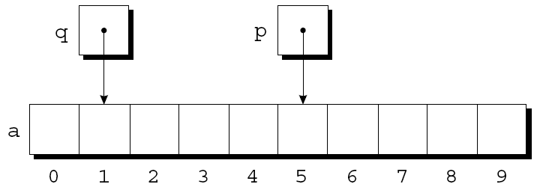
Subtracting One Pointer from Another
When one pointer is subtracted from another, the result is the distance (measured in array elements) between the pointers.
If p points to a[i] and q points to a[j], then p - q is equal to i - j.
p = &a[5];
q = &a[1];
i = p - q; /* i is 4 */
i = q - p; /* i is -4 */

Slide 13
Operations that cause undefined behavior
Performing arithmetic on a pointer that doesn’t point to an array element
int i, *p, *q;
p = &i;
q = p+3; //wrong
Subtracting pointers but they do not point to elements of the same array
int a[10], b[20];
p = &a[0]; q =&b[10];
int i = q – p; //wrong

Slide 14
Pointer Arithmetic – how does it work?
Integers used in pointer arithmetic are scaled depending on the type of the pointer.
For example,
If p is of type int *, then p + j typically adds 4 x j to p, assuming that int values are stored using 4 bytes (usually).
But if p has type double *, then p + j will probably add 8 x j to p, since double values are usually 8 bytes long.

Slide 15
Exercise
int a[]={6, 19, 35, 74, 23, 16};
int *p = &a[1];
int *q = &a[5];
What’s the value of *(p+3)?
A)74
B)23
C)24
D)16
E)None of the above

Slide 16
Exercise
int a[]={6, 19, 35, 74, 23, 16};
int *p = &a[1];
int *q = &a[5];
What’s the value of *(q-3)?
A)74
B)13
C)19
D)35
E)None of the above

Slide 17
Exercise
int a[]={6, 19, 35, 74, 23, 16};
int *p = &a[1];
int *q = &a[5];
What’s the value of q - p?
A)4
B)-4
C)3
D)-3
E)None of the above

Slide 18
Exercise
int a[]={6, 19, 35, 74, 23, 16};
int *p = &a[1];
int *q = &a[5];
What’s the value of *q - *p?
A)4
B)-4
C)3
D)-3
E)None of the above

Slide 19
Comparing Pointers
Pointers can be compared using the relational operators (<, <=, >, >=) and the equality operators (== and !=).
Using relational operators is meaningful only for pointers to elements of the same array.
The outcome of the comparison depends on the relative positions of the two elements in the array.
If p points to an element of an array at a smaller index than an element pointed by q, then p is less than q.

Slide 20
Comparing Pointers
For example, after the assignments
p = &a[5];
q = &a[1];
the value of p <= q is 0 and the value of p >= q is 1.

Slide 21
Exercise
int a[]={6, 19, 35, 74, 23, 15};
int *p = &a[1];
int *q = &a[5];
What is the value of the condition p < q?
1(true)
0(false)

Slide 22
Exercise
int a[]={6, 19, 35, 74, 23, 15};
int *p = &a[1];
int *q = &a[5];
What is the value of the condition *p < *q?
1(true)
0(false)

Slide 23
Using Pointers for Array Processing
Pointer arithmetic allows us to visit the elements of an array by repeatedly incrementing a pointer variable.
A loop that sums the elements of an array a:
#define N 10
int a[N], *p;
int sum = 0;
…
for (p = &a[0]; p < &a[N]; p++)
sum += *p;

Slide 24
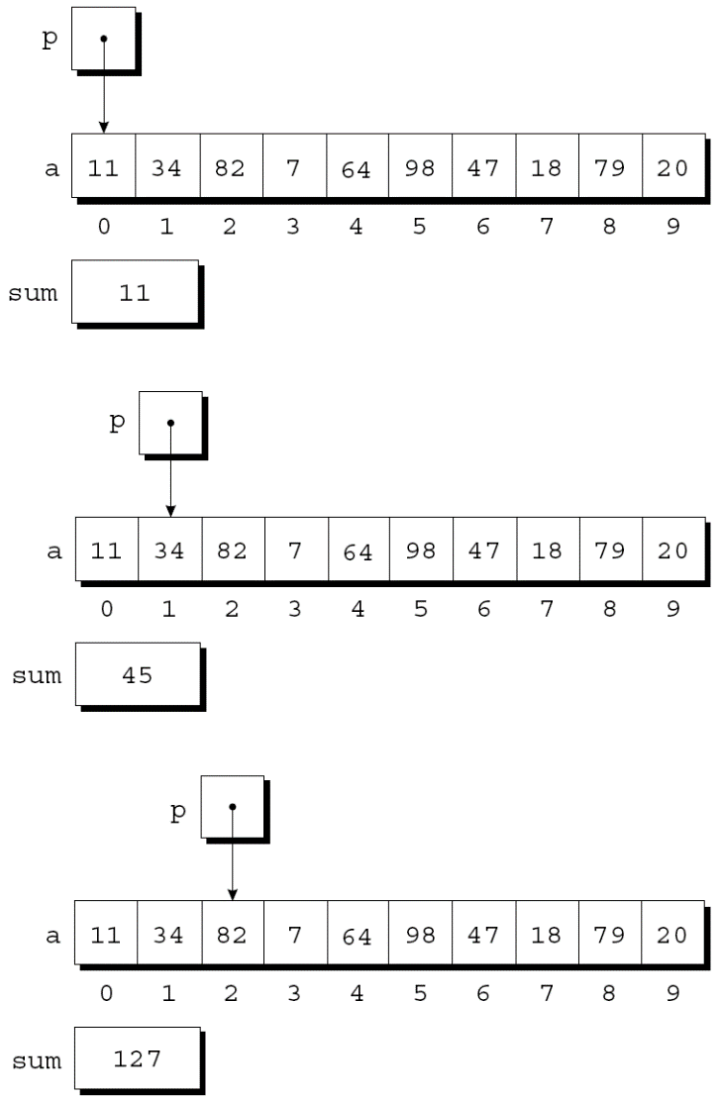
Using Pointers for Array Processing
At the end of the first iteration:
At the end of the second iteration:
At the end of the third iteration:

Slide 25
Using Pointers for Array Processing
The condition p < &a[N] in the for statement:
It’s legal to apply the address operator to a[N], even though this element doesn’t exist.
It’s safe since the loop doesn’t attempt to examine its value.
Loop teminates when p is equal to &a[N].

Slide 26
Example Program
Modify max_min program which finds the largest and smallest elements in an array using pointer arithmetic

Slide 27
Exercise, Part 1
Rewrite the following function to count the number of elements greater than value.
Use pointer arithmetic instead of array subscripting.
int compare_array(int a[], int n, int value)
{
int i, count = 0;
for(i= 0; i <n; i++)
if(a[i]>value)
count ++;
return count;
}

Slide 28
Part 1, Main function
Test the two functions in main:
int main()
{ int count=0;
int a[7] = {3, 42, 52, 91, 2, 13, 49};
count = compare_array(a, 7, 25);
printf("the number of elements greater than 25 is: %d\n", count);
return 0;
}

Slide 29
Exercise, Part 2
A vector is an ordered collection of values in mathematics. An array is a very straightforward way to implement a vector on a computer.
Two vectors can be multiplied on an entry-by-entry basis, e.g. (1, 2, 3) * (4, 5, 6) = (4, 10, 18). Write the following function that multiplies two vectors.
void multi_vec (int v1[], int v2[], int v3[], int n);
The multi_vec function multiplies vectors v1 and v2 and stores the result in v3. n is the length of the vectors. The function should use pointer arithmetic.

Slide 30
Exercise, Part 2, Cont’d, main function
int main(void)
{
int i, size;
printf("Please enter the length of the vectors:\n");
scanf("%d", &size);
int a[size], b[size], c[size];
printf("enter the first vector");
for(i=0;i<size;i++)
scanf("%d", &a[i]);
printf("enter the second vector");
for(i=0;i<size;i++)
scanf("%d", &b[i]);
multi_vec(a, b, c, size);
for(i=0;i<size;i++)
printf("%d\t", c[i]);
return 0;
}

